Slide 1
Intel Edison Board Fall & Activity Detection With Bluetooth Communication

Slide 2


Slide 3
Project Overview
Our project is the beginning of an exercise activity and health monitor, using an embedded processor and sensor to monitor the user’s activity and a Windows server to process the signal from the monitor and act accordingly.

Slide 4
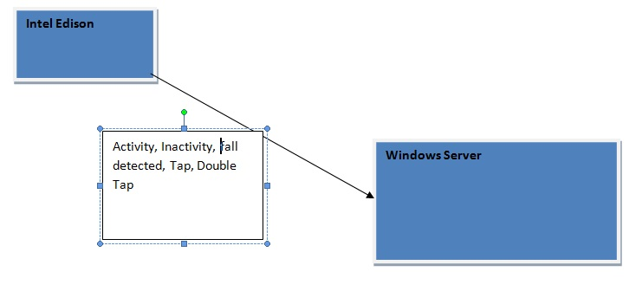

Slide 5
The intel Edison will receive an interrupt from the sensor if any of these activities are detected:
FALL: If a fall occurs and no activity is detected after a certain period of time emergency is called and an alarm goes off.
ACTIVITY: Used to keep track of how many calories have been burned.
TAP: User or emergency care needs to tap the device to stop the alarm.
DOUBLE TAP: Used to indicate user is OK.

Slide 6
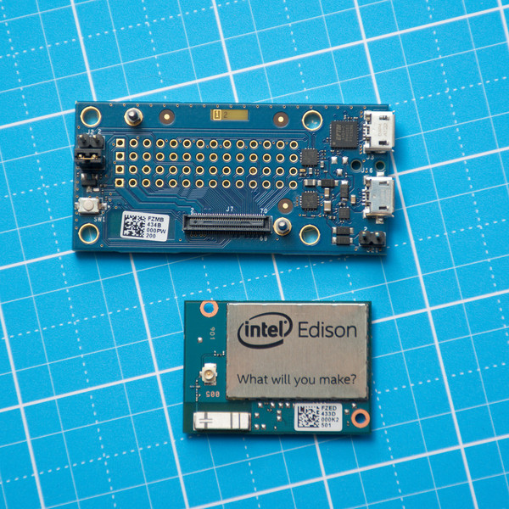
COTS product Reuse
We will use an off the shelf hardware platform; the Intel Edison.
It is a mini computer the size of an SD card and comes with Linux already installed.

Slide 7
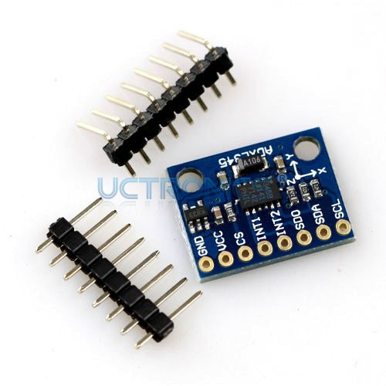
Design With Reuse: Sensors
We will use the ADXL345 sensor which uses the I2C bus when connected to the Edison board for communication.
Linux has SMBus which is a sibling protocol of I2C and is I2C con- formant and can be used for i2C communications.
Python has an SMBus module which is a wrapper around the Linux SMBUS and we will reuse this to make communication with the sensor easier through Python instead of using I2C directly or writing our own driver.

Slide 8
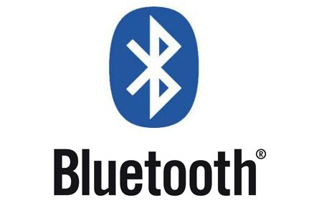
Design For Reuse: Bluetooth
We will make the Bluetooth part of the communications modular so that it can be reused easily.

Slide 9
Embedded Development
We will have separate processes for both data collection and blue-tooth communication running as Python programs.
Linux is not an RTOS, but since this application is real time we might have to apply the RT patch to Linux so that process deadlines are met after events happen like a patient falling.

Slide 10
***System Design Using Stimulus Response Model
Periodic sensor stimuli
Stimulus | Response
Activity Detected | Activate Bluetooth and send activity string to Windows PC over Bluetooth.
Fall Detected | Send fall string to Windows PC.
Tap Detected | Send tap string to Windows PC
Double-Tap Detected | Send double-tap string to Windows PC.

Slide 11
Limitations
Limited battery life provided by LIPO battery so battery management must be considered.
This means that we will have to code with power efficiency in mind so that we don't exhaust the system's battery life. We will need to manage the sensor and Bluetooth use to ensure battery longevity. We also need to define how long the system will last while running in normal mode.

Slide 12
Desktop-Side
The data acquired from the sensors via the Edison board and transmitted via Bluetooth will need to be received and processed. A Java program running off of a desktop will handle this.
Java has a Bluetooth API with many libraries meeting the API specifications, as well as strong GUI support and platform independence. The Bluetooth implementation we will be using is Bluecove.

Slide 13
Programming with Reuse in Reception/Processing
Using the existing Java Bluetooth library takes care of a relatively difficult task that could be tricky to get correct and take a long time. In addition, reusing this library is unlikely to result in problems as Java is used extensively for mobile Apps and errors in the library would be spotted and rectified quickly.
Existing libraries can also be used for formatting, writing, and storing the data received from the sensors.

Slide 14
Programming for Reuse in Reception/Processing
The signal reception and processing modules can be written separately and abstractly, such that they can be reused for other, similar applications. The operations carried out on received information can be left as parameters, rather than hardcoded in, and the information reception parser can be written as an abstract class with different handling methods implemented.

Slide 15
Modules / Components
All in all, the project will have four components. First on the embedded side there is the sensor array and its code for collecting data. Second, there is the Edison board’s pre-processing and transmission via Bluetooth of the data. Third, there is the desktop thread that will receive the transmitted data, and finally the thread that processes, acts upon, and displays the received data.

Slide 16
Project Planning & Task Allocation
Jheddy: Communication with the sensors and sensor data pre-processing
Nathaniel: Bluetooth communication with Windows machine and Windows-side GUI/display.

